Slide 1
Murach’s PHP and MySQL (4th Edition)
Chapter 16
How to design a database

Slide 2
Applied objectives
Given the specifications for a database modeled on a real-world system, design the database. That is, identify the tables, columns, keys, relationships, and indexes for the new database.
Given a diagram for an unnormalized database, normalize the structure to the third normal form.

Slide 3
Knowledge objectives
Describe the process of designing a database in terms of tables, columns, keys, and relationships.
Describe referential integrity, and explain how enforcing it assures that the database isn’t corrupted when rows are inserted, updated, or deleted.
Explain how normalizing a database to the third normal form improves database performance.
In general terms, describe the criteria for indexing a column.

Slide 4
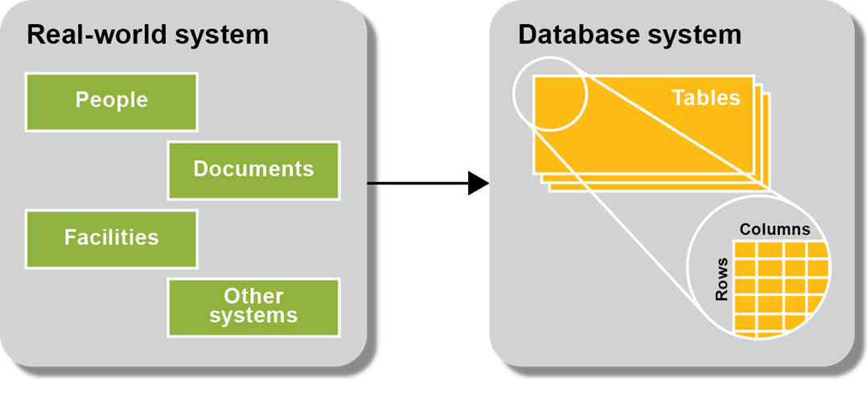
A database system is modeled after a real-world system

Slide 5
The six basic steps for designing a data structure
Step 1: Identify the data elements
Step 2: Subdivide each element into its smallest useful components
Step 3: Identify the tables and assign columns
Step 4: Identify the primary and foreign keys
Step 5: Review whether the data structure is normalized
Step 6: Identify the indexes

Slide 6
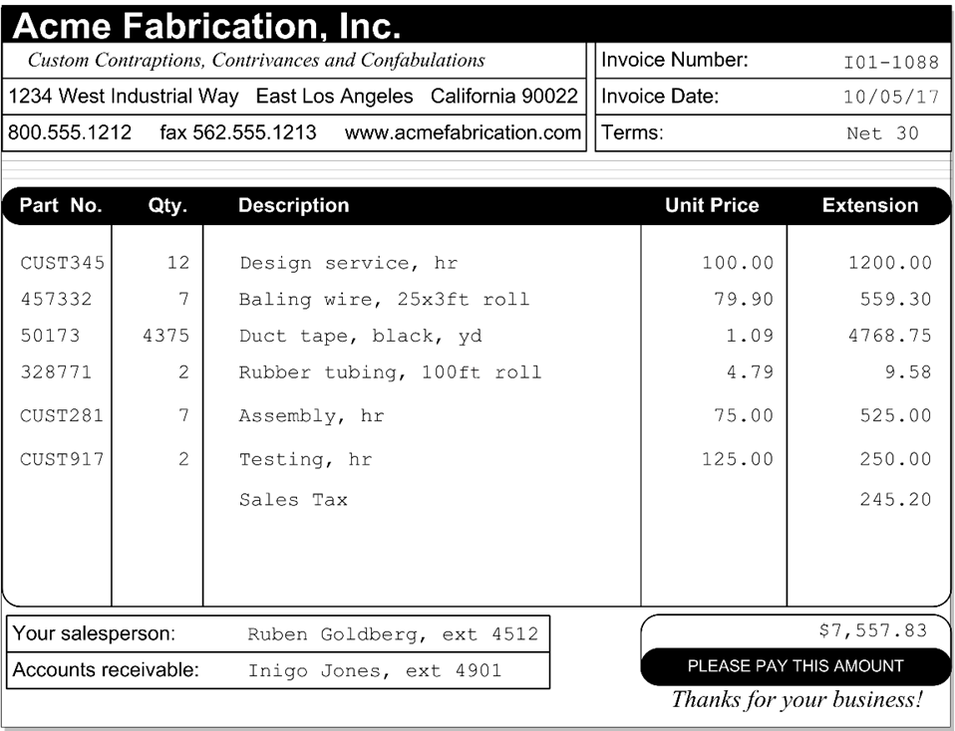
An invoice that can be used to identify data elements

Slide 7
The data elements identified on the invoice
Vendor name Invoice date Item extension
Vendor address Invoice terms Vendor contact name
Vendor phone number Item part number Vendor contact ext.
Vendor fax number Item quantity Vendor AR contact name
Vendor web address Item description Vendor AR contact ext.
Invoice number Item unit price Invoice total

Slide 8
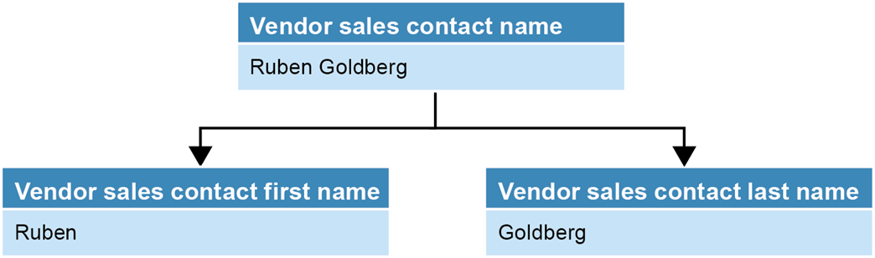
A name that’s divided into first and last names

Slide 9
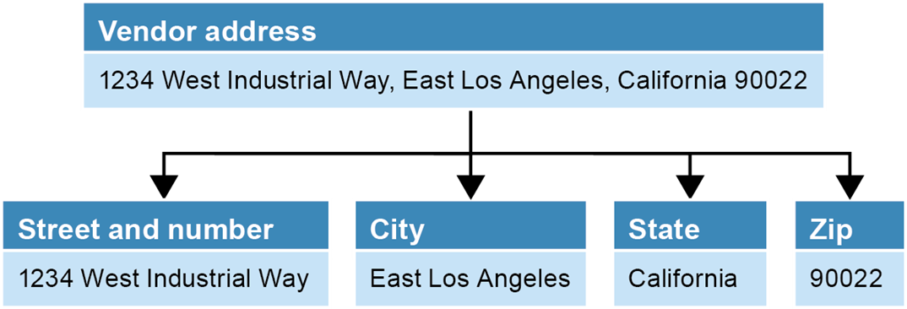
An address that’s divided into street address, city, state, and zip code

Slide 10
Possible tables and columns for an A/P system
(part 1)
Vendors table
Vendor name Vendor contact first name
Vendor address Vendor contact last name
Vendor city Vendor contact phone
Vendor state Vendor AR first name
Vendor zip code Vendor AR last name
Vendor phone number Vendor AR phone
Vendor fax number Terms*
Vendor web address Account number*
Data elements that were added
*Data element related to two or more entities

Slide 11
Possible tables and columns for an A/P system
(part 2)
Invoices table Invoice line items
Invoice number* Invoice number*
Invoice date Item part number
Terms* Item quantity
Invoice total Item description
Payment date Item unit price
Payment total Item extension
Invoice due date Account number*
Credit total Sequence number
Account number*

Slide 12
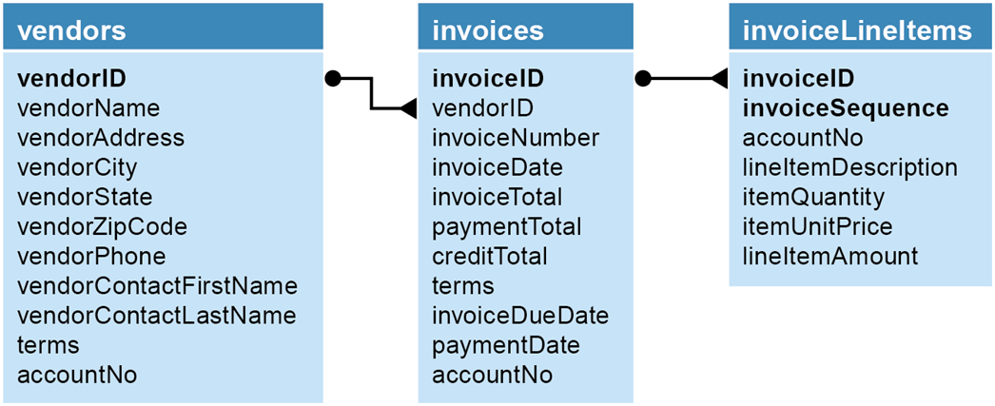
The relationships between the tables in the accounts payable system

Slide 13
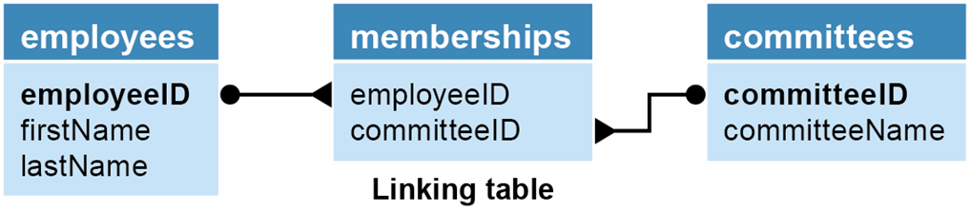
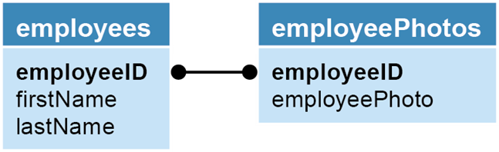
Two tables with a many-to-many relationship
Two tables with a one-to-one relationship

Slide 14
Operations that can violate referential integrity
This operation… | Violates referential integrity if…
Delete a row from the primary key table | The foreign key table contains one or more rows related to the deleted row
Insert a row in the foreign key table | The foreign key value doesn’t have a matching primary key value in the related table
Update the value of a foreign key | The new foreign key value doesn’t have a matching primary key value in the related table
Update the value of a primary key | The foreign key table contains one or more rows related to the row that’s changed

Slide 15
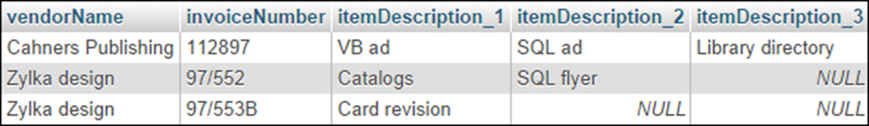
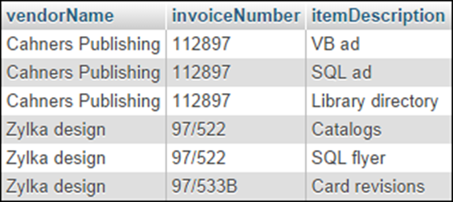
A table that contains repeating columns
A table that contains redundant data

Slide 16
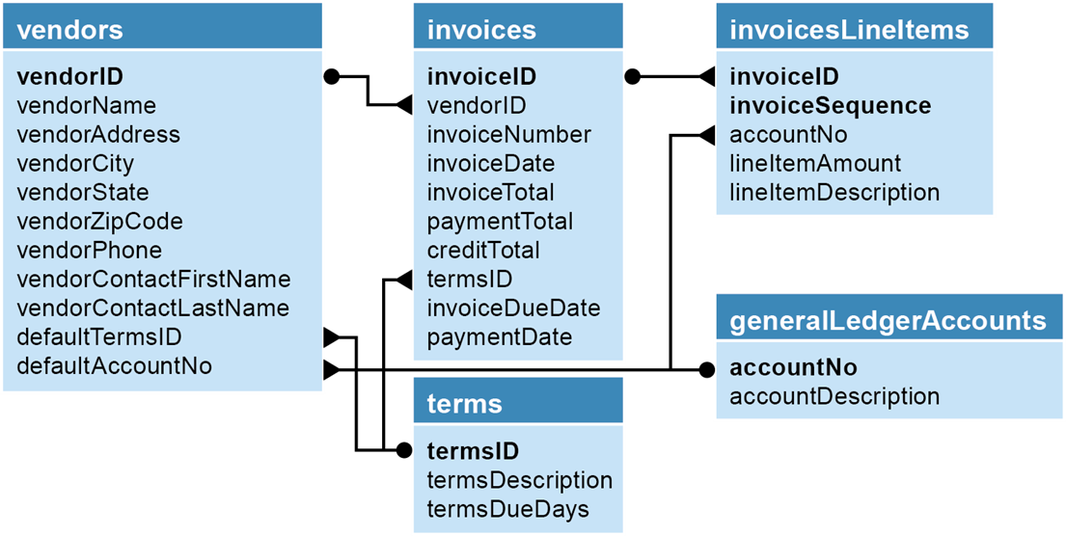
The accounts payable system in third normal form

Slide 17
About indexes
An index provides a way for a database management system to locate information more quickly.
MySQL automatically creates an index for a primary key.
Indexes speed performance when searching and joining tables.
You can create composite indexes that include two or more columns.
Because indexes must be updated each time you add, update, or delete a row, you shouldn’t create more indexes than you need.
When to create an index
When the column is a foreign key
When the column is used frequently in search conditions or joins
When the column contains a large number of distinct values
When the column is updated infrequently

Slide 18
The seven normal forms
First (1NF)
Second (2NF)
Third (3NF)
Boyce-Codd (BCNF)
Fourth (4NF)
Fifth (5NF)
Domain-key (DKNF) or Sixth (6NF)

Slide 19
The benefits of normalization
Since a normalized database has more tables than an unnormalized database, and since each table has an index on its primary key, the database has more indexes. That makes data retrieval more efficient.
Since each table contains information about a single entity, each index has fewer columns (usually one) and fewer rows. That makes data retrieval and insert, update, and delete operations more efficient.
Each table has fewer indexes, which makes insert, update, and delete operations more efficient.
Data redundancy is minimized, which simplifies maintenance and reduces storage.

Slide 20
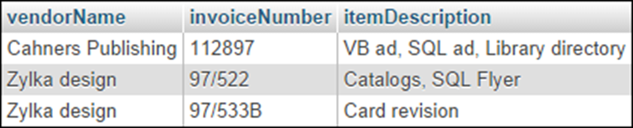
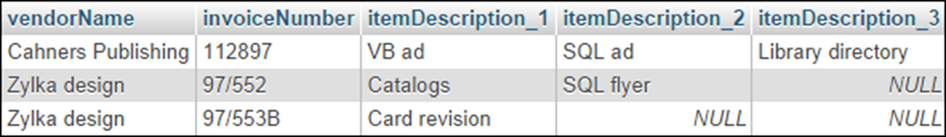
The invoice data with a column that contains repeating values
The invoice data with repeating columns

Slide 21
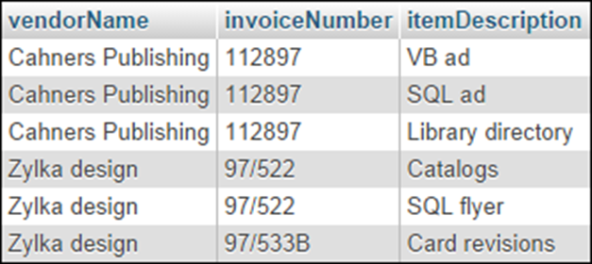
The invoice data in first normal form

Slide 22
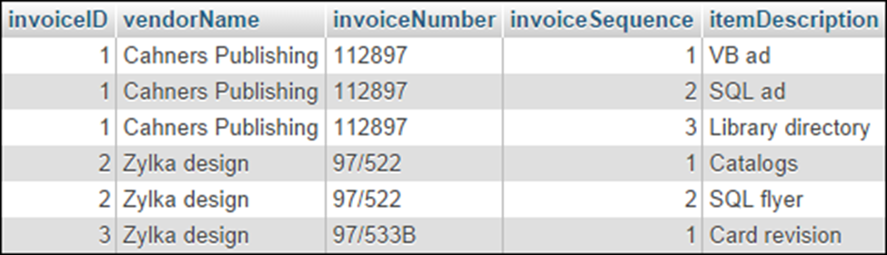
The invoice data in first normal form with keys

Slide 23
The invoice data in second normal form

Slide 24
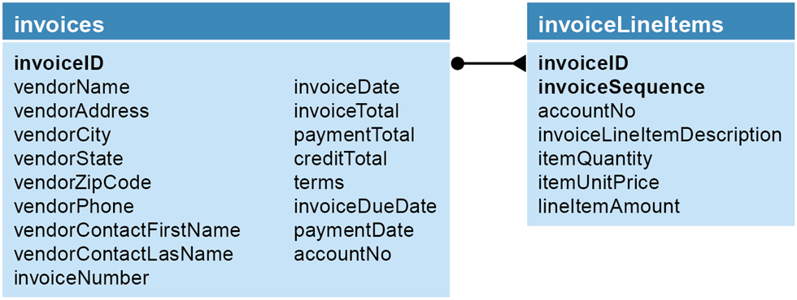
The A/P system in second normal form
Questions about the structure
Does the vendor information depend only on the invoiceID column?
Does the terms column depend only on the invoiceID column?
Does the accountNo column depend only on the invoiceID column?
Can the invoiceDueDate and lineItemAmount columns be derived from other data?

Slide 25

The A/P system in third normal form

Slide 26
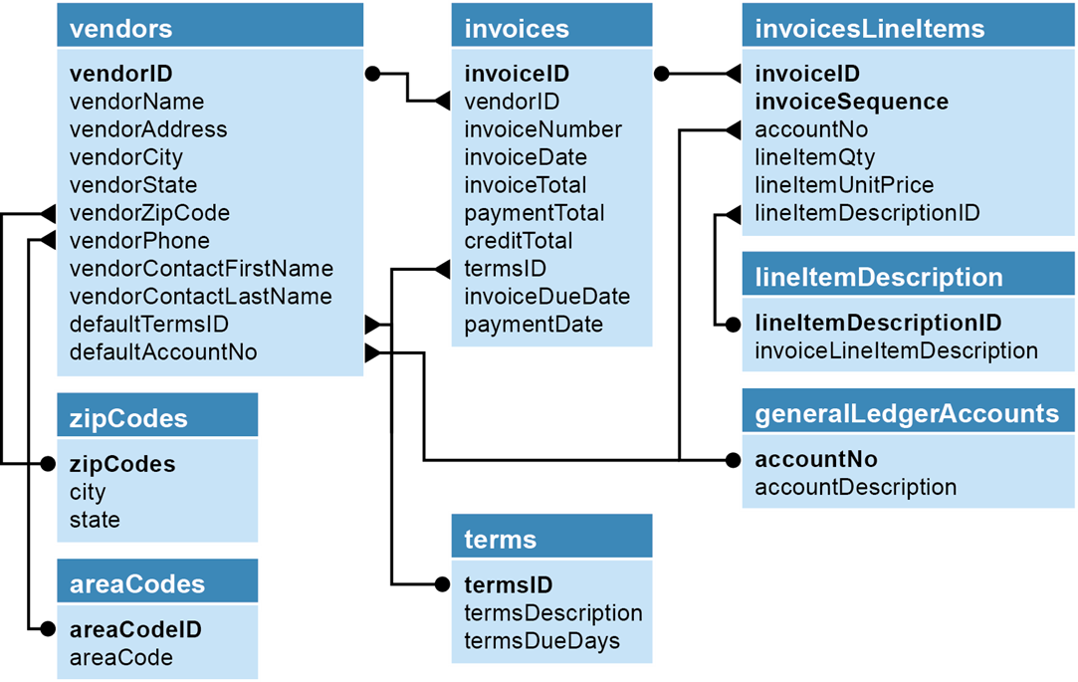
The accounts payable system in fifth normal form

Slide 27
When to denormalize
When a column from a joined table is used repeatedly in search criteria, you should consider moving that column to the primary key table if it will eliminate the need for a join.
If a table is updated infrequently, you should consider denormalizing it to improve efficiency. Because the data remains relatively constant, you don’t have to worry about data redundancy errors once the initial data is entered and verified.
Include columns with derived values when those values are used frequently in search conditions. If you do that, you need to be sure that the column value is always synchronized with the value of the columns it’s derived from.

